Slide 1
Research and Discovery
Jared Nightingale & Anthony Tran
Notes:
Both

Slide 2
Spreetail Senior Design Project
Create a hardware and software solution that allows a user to control hardware that takes consistent, high quality photography of rotating products.
Front end that allows user control
Communication system for fast data transfer
Control tower to control cameras and communicate with front end
Notes:
Ant

Slide 3
Outline
What is Research and Discovery?
Research and Discovery Mindset
The Process
Meeting with Sponsor
Research
Trials and Testing
Closing Statements
Questions?
Notes:
Jared

Slide 4
What is Research and Discovery?
“The systematic, rigorous investigation of a situation or problem in order to generate new knowledge or validate existing knowledge.” ¹
Studying the problem through sponsor meetings
What is the problem?
Why does this problem exist?
Studying existing solutions (validation)
What are these solutions?
Why are these solutions feasible/not feasible for my sponsor?
Researching new solutions (discovery)
How can we solve this problem in a new way?
1. https://medical-dictionary.thefreedictionary.com/Research+and+discovery
Notes:
Ant
Slow but well thought out plan of how to attack a problem
Generate new knowledge → discovery
Go through each of these points with examples from our project
In our case, the sponsor had done some previous research into existing solutions, but the problem was the cost.
Came to us to find a cheaper solution

Slide 5
Research and Discovery Mindset
Slow initial progress
Research and testing takes time
Be comfortable with uncertainty
Don’t commit to solutions too early
Requirements and road map can change at any time
Be ready to accept failure
Failure may lead to better solutions, encourages problem solving
Always confirm solutions with sponsor before starting development
Eagerness can lead to loss of progress
Notes:
Ant

Slide 6
The Process
Trials and Testing
03
Meet with Sponsor
01
02
Research/Discovery
Notes:
Ant

Slide 7
Meeting With Sponsor
Define requirements during initial meetings
Requirements shape the research to be done
Refine requirements during later meetings
Research and testing can adjust requirements/scope
Provide results
Never provide “half ideas”
Mutual decisions with sponsor
Gain approval for development
Reshape requirements for further research
Notes:
Ant
Always want to be transparent with sponsor
Always want to be on the same page
Our group has changed direction numerous times throughout research and discovery process

Slide 8
Research
Where to start:
What existing solutions exist for the problem at hand?
Why don’t the sponsors move forward with these solutions?
Cost?
Quality?
Flexibility?
Take Sponsor suggestions into account
Research for new solutions with a focus on these aspects
Never too many possible solutions
Keep solutions reasonable → avoid the “cool factor”
Notes:
Jared
Want to find solutions that explicitly solve the sponsor’s problem, not find something that would be cool to work on/with

Slide 9
Trials and Testing
Divide solutions into project components for testing
Develop criteria to compare possible solutions for each component
Don’t go too far into testing specific solutions
This loses valuable time
Only test far enough to ensure viability and feasibility
Don’t be afraid to drop solutions
Gather notes to be reported to sponsor
Results are the most important part of testing
Notes:
Jared

Slide 10
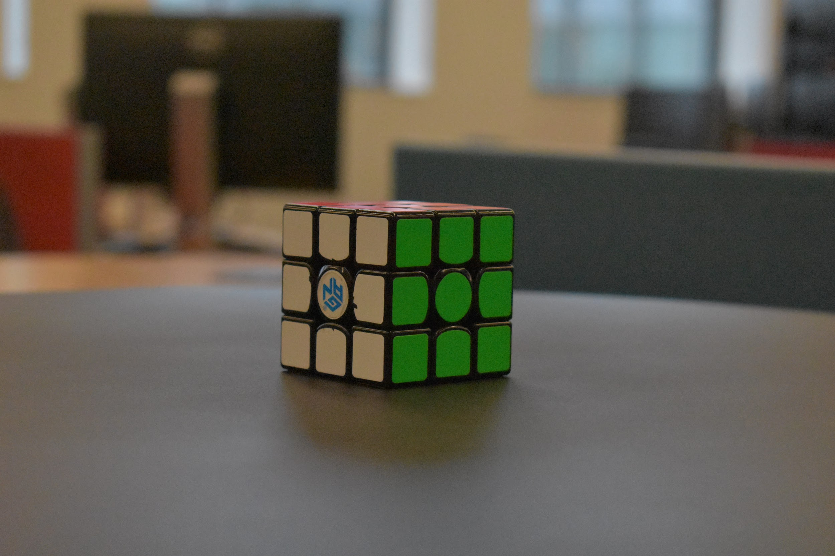
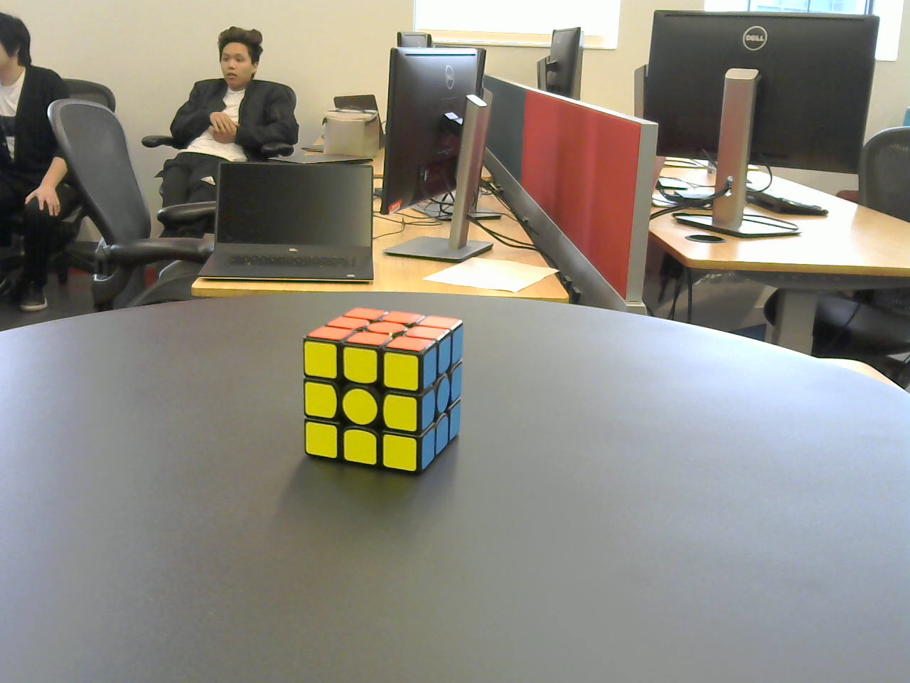
Trials and Testing: Example
Cameras - DSLR vs. Webcam
Image quality, usability, cost
DSLR
Webcam
Notes:
Jared
Had to borrow cameras and webcams in order to perform testing
Couldn’t buy these products just to test them and have them not work
Sometimes sponsors will have ideas for solutions that could be useful → Messaging service → Led to finding Azure Service Bus

Slide 11
Closing Statements
Research and uncertainty leads to slow initial progress while roadmap and requirements are being laid out.
Developing possible solutions takes time, and in order to test some solutions, code must be written and tested as well.
Research and Discovery allows for more creativity, but has an expectation of flexibility to allow easy shifts in scope and requirements.
Notes:
Jared

Slide 12
Questions?
Notes:
Both

